Slide 1
Visualizing and Exploring Data using Excel

Slide 2
Topics
Data Visualization
Data Queries: Using Sorting and Filtering
Statistical Methods for Summarizing Data
Exploring Data Using PivotTables

Slide 3
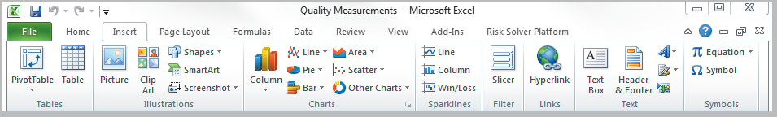
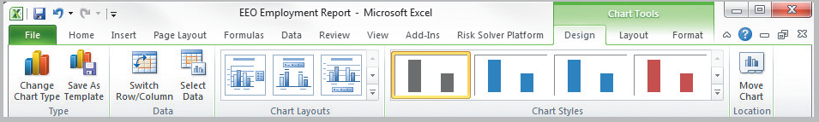
Data Visualization
Creating Charts in Microsoft Excel
Select the insert tab.
Highlight the data.
Click on chart type, then subtype.
Use chart tools to customize.
Figure 3.1
Figure 3.2

Slide 4
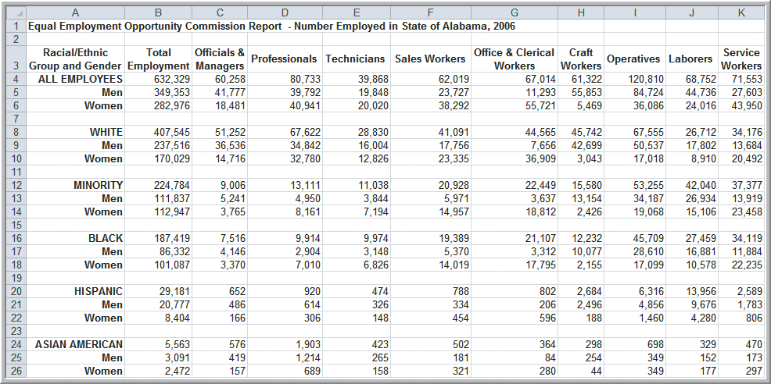
Data Visualization
Example 1 Creating a Column Chart
Highlighted Cells
Figure 3.3

Slide 5
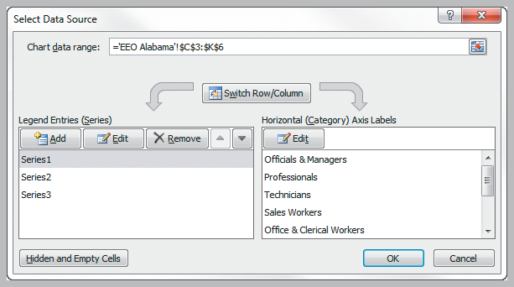
Data Visualization
Example 1 (continued) Creating a Column Chart
Choose column chart (clustered or stacked).
Add chart title (Alabama Employment).
Rename Series1, Series2, and Series3
(ALL EMPLOYEES, Men, Women).
Figure 3.4

Slide 6
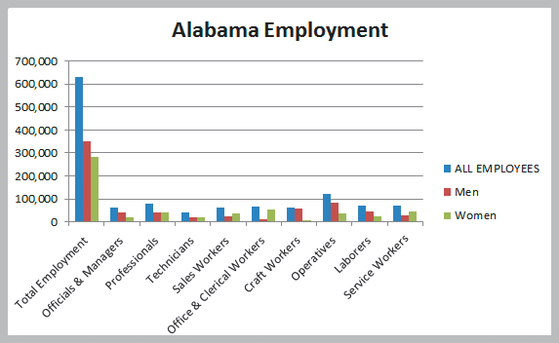
Data Visualization
Example 1 (continued) Creating a Column Chart
Clustered
Column
Chart
Figure 3.5

Slide 7
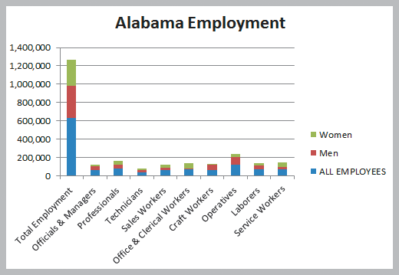
Data Visualization
Example 1 (continued) Creating a Column Chart
Stacked
Column
Chart
Figure 3.6

Slide 8
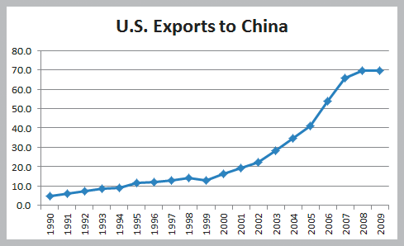
Data Visualization
Example 2 Line Chart for U.S. Exports to China
Figure 3.7

Slide 9
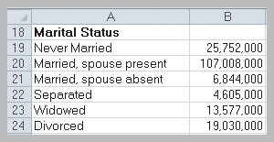
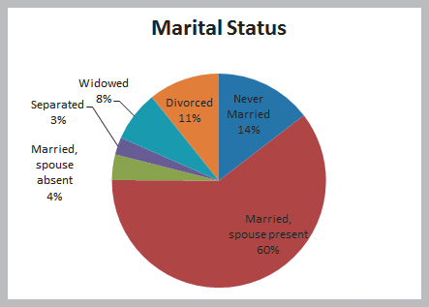
Data Visualization
Example 3 Pie Chart for Census Data

Slide 10
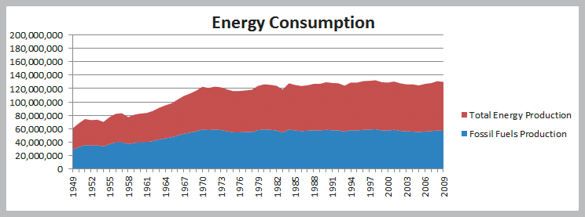
Data Visualization
Example 4 Area Chart for Energy Consumption

Slide 11
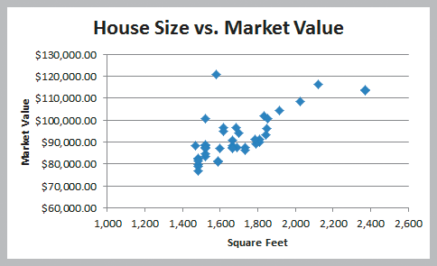
Data Visualization
Example 5 Scatter Chart for Real Estate Data

Slide 12
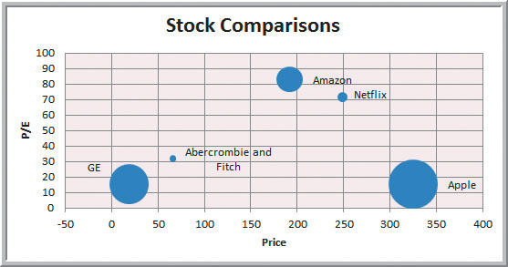
Data Visualization
Example 6
Bubble Chart for Comparing Stock Characteristics

Slide 13
Data Visualization
Miscellaneous Excel Charts
Stock chart
Surface chart
Doughnut chart
Radar chart
Geographic mapping

Slide 14
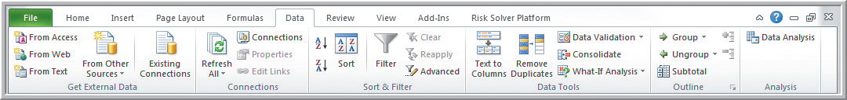
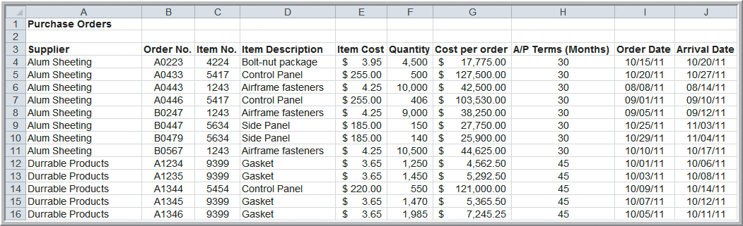
Data Queries: Using Sorting and Filtering
Example 7
Sorting Data in the Purchase Orders Database
Sort by Supplier

Slide 15
Data Queries: Using Sorting and Filtering
Pareto Analysis
An Italian economist, Vilfredo Pareto, observed in 1906 that a large proportion of the wealth in Italy was owned by a small proportion of the people.
Similarly, businesses often find that a large proportion of sales come from a small proportion of customers.
A Pareto analysis involves sorting data and calculating cumulative proportions.

Slide 16
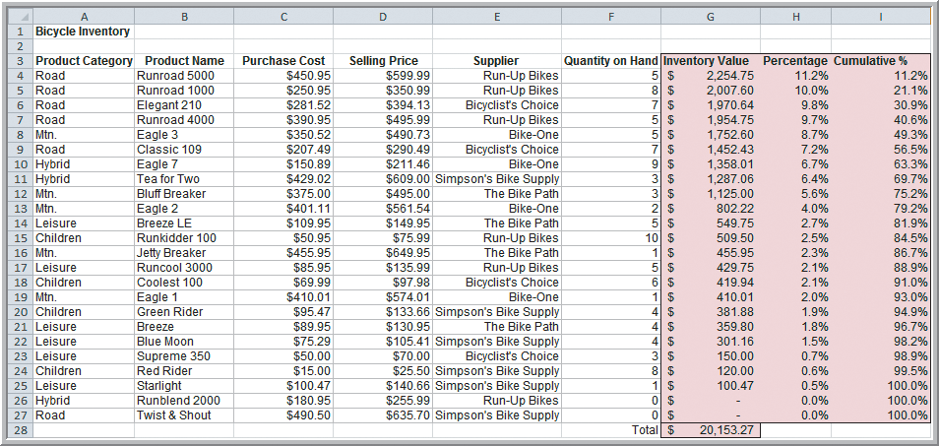
Data Queries: Using Sorting and Filtering
Example 8 Applying the Pareto Principle
Sort by
75% of the bicycle inventory value comes from 40% (9/24) of items.
Figure 3.15

Slide 17
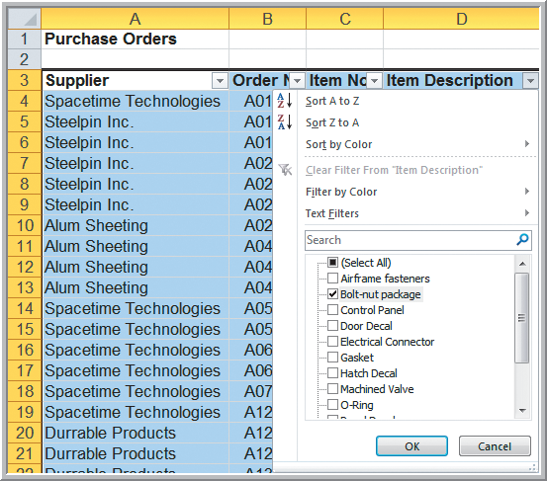
Data Queries: Using Sorting and Filtering
Example 9 Filtering Records by Item Description
Highlight A3:J97
Data tab
Sort & Filter group
Filter
Click on the D3
dropdown arrow.
Select Bolt-nut
package to filter out
all other items.

Slide 18
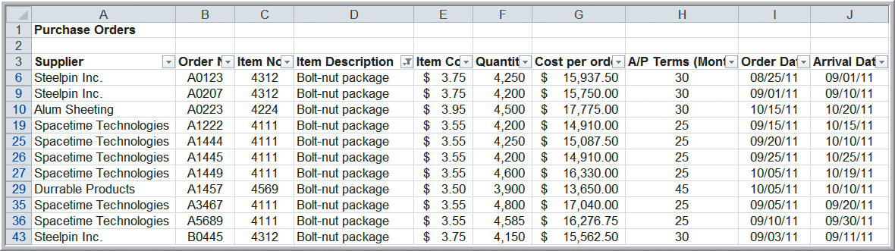
Data Queries: Using Sorting and Filtering
Example 9 (continued)
Filtering Records by Item Description
Filter results for the bolt-nut package

Slide 19
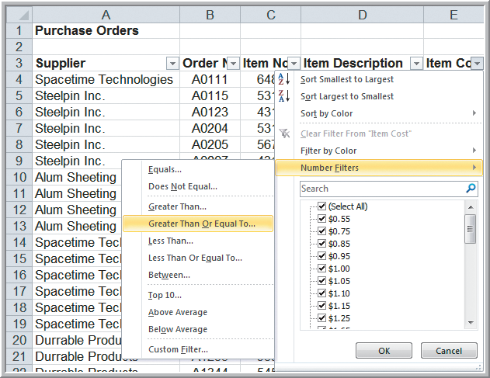
Data Queries: Using Sorting and Filtering
Example 10 Filtering Records by Item Cost
To identify items that
cost at least $200
Click on dropdown
arrow for item cost
Number Filters
Greater Than Or
Equal To…

Slide 20
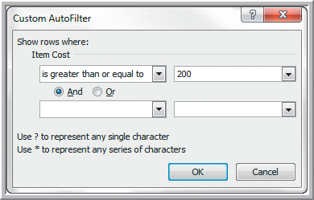
Data Queries: Using Sorting and Filtering
Example 10 (continued) Filtering by Item Cost Custom AutoFilter dialog box
Click OK
Only items
costing at least
$200 is then
displayed.

Slide 21
Data Queries: Using Sorting and Filtering
AutoFilter criteria is based on the data type.
Number Filters includes numerical criteria.
Date Filters include tomorrow, next week, etc.
AutoFilter can be used sequentially.
First filter by one variable.
Then filter those data by another variable.

Slide 22

Data Queries: Using Sorting and Filtering
Analytics in Practice: Discovering Value
of Data Analysis at Alders International
Duty free operations at airports, seaports, etc.
Maintain a data warehouse to track point-of-sale information and inventory levels.
Pareto analysis revealed that 80% of profits were generated from 20% of their product lines.
Allows selective elimination of less profitable items.

Slide 23
Statistical Methods for Summarizing Data
A statistic is a summary measure of data.
Descriptive statistics are methods that describe and summarize data.
Microsoft Excel supports statistical analysis in two ways:
1. Statistical functions
2. Analysis Toolpak add-in for PCs
(for Macs, StatPlus is similar)
Statistical methods are essential to Business Analytics

Slide 24
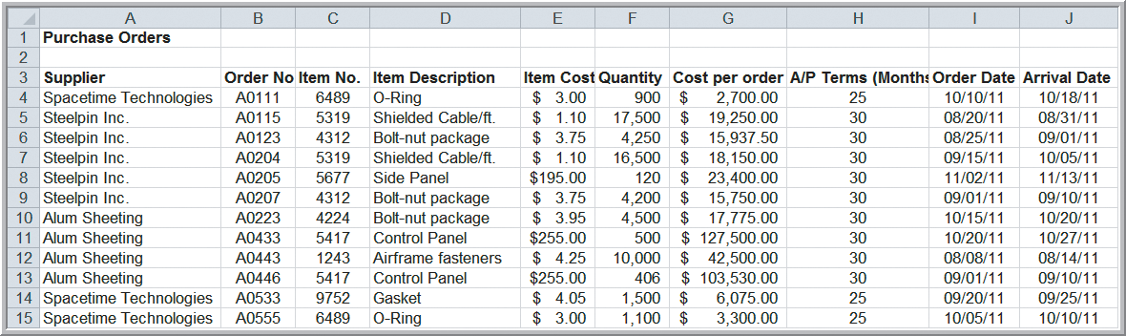
Statistical Methods for Summarizing Data
Example 11 Constructing a Frequency Distribution
for Items in the Purchase Order Database
Copy Column D (Item Description) to Column A in a new worksheet

Slide 25
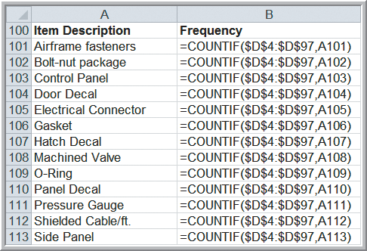
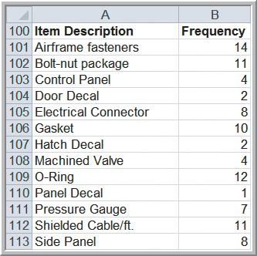
Statistical Methods for Summarizing Data
Example 11 (continued) Constructing a Frequency Distribution for Items in the Purchase Order Database
Figure 3.21
Figure 3.22

Slide 26
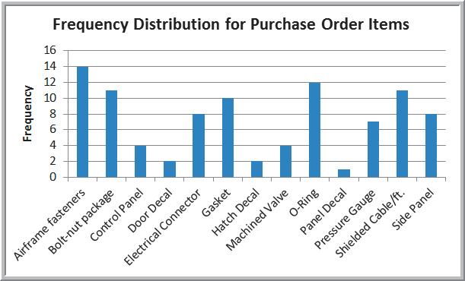
Statistical Methods for Summarizing Data
Example 11 (continued) Constructing a Frequency Distribution for Items in the Purchase Order Database

Slide 27
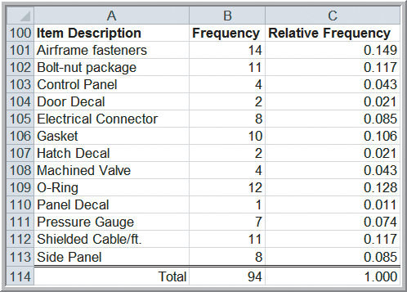
Statistical Methods for Summarizing Data
Example 12 Constructing a Relative Frequency Distribution for Items Purchased
Compute relative frequencies by
dividing each frequency by 94.

Slide 28
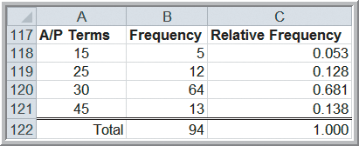
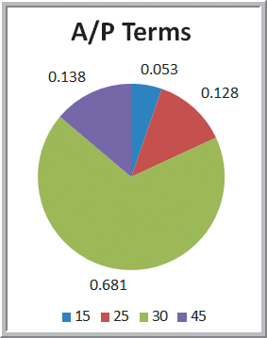
Statistical Methods for Summarizing Data
Example 13 Frequency and Relative Frequency Distribution for A/P Terms

Slide 29
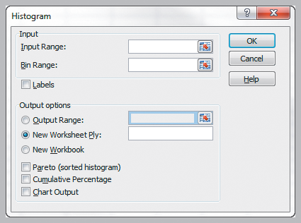
Statistical Methods for Summarizing Data
Excel’s Histogram Tool
Using the Analysis Toolpak
Data
Data Analysis
Histogram
Fill in the Input Range and Bin Range (optional).
Choose Labels if columns have headers rows.
Choose Chart Output.

Slide 30
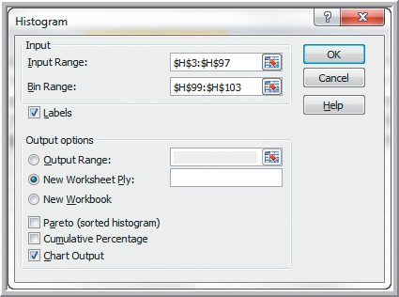
Statistical Methods for Summarizing Data
Example 14
Using the Histogram Tool for A/P Terms
A/P data in H3:H97
Bins below in H99:H103
Month
15
25
30
45

Slide 31
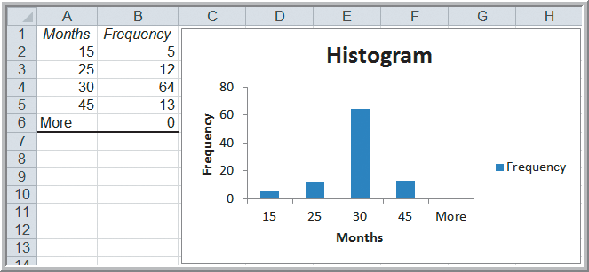
Statistical Methods for Summarizing Data
Example 14 (continued)
Using the Histogram Tool for A/P Terms
Table above is not linked to chart.

Slide 32
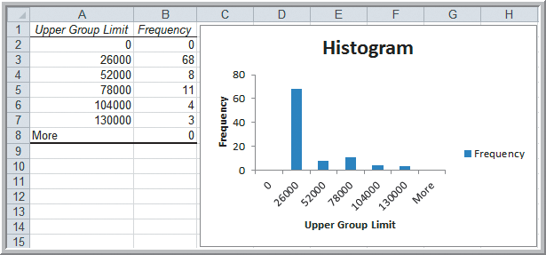
Statistical Methods for Summarizing Data
Example 3.15 Constructing a Frequency Distribution and Histogram for Cost Per Order
5 groups with a
$26,000 group width

Slide 33
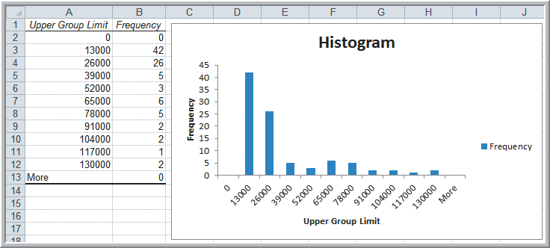
Statistical Methods for Summarizing Data
Example 15 (continued) Constructing a Frequency Distribution and Histogram for Cost Per Order
10 groups with a
$13,000 group width

Slide 34
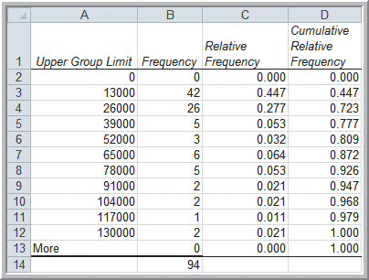
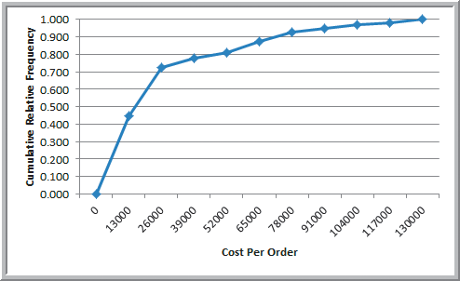
Statistical Methods for Summarizing Data
Example 16 Computing Cumulative Relative Frequencies for the Cost Per Order Data

Slide 35
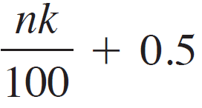
Statistical Methods for Summarizing Data
Example 17 Computing Percentiles
Compute the 90th percentile for cost per order in the Purchase Orders Data.
Rank of k^{th} percentile =
n = 94 observations
k = 90
Rank of 90th percentile = 94(90)/100+0.5
= 85.1 (round to 85)
Value of the 85th observation = $74,375

Slide 36
Statistical Methods for Summarizing Data
Example 18 Computing Percentiles in Excel
Compute the 90th percentile for cost per order.
Excel function for the k^{th} percentile: =PERCENTILE.INC(array, k)
=PERCENTILE.INC(G4:G97, 0.90)
= $73,737.50
Excel does not use the formula on previous slide.

Slide 37
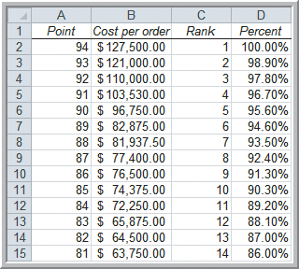
Statistical Methods for Summarizing Data
Example 19 Excel’s Rank and Percentile Tool
Data
Data Analysis
Rank and Percentile
90.3rd percentile
= $74,375
(same result as
manually computing
the 90th percentile)

Slide 38
Statistical Methods for Summarizing Data
Example 20 Computing Quartiles in Excel
Compute the Quartiles of the Cost per Order data
Excel function for quartiles: =QUARTILE.INC(array, quart)
=QUARTILE.INC(G4:G97, 1) = $6,757.81
=QUARTILE.INC(G4:G97, 2) = $15,656.25
=QUARTILE.INC(G4:G97, 3) = $27,593.75
=QUARTILE.INC(G4:G97, 4) = $127,500.00

Slide 39
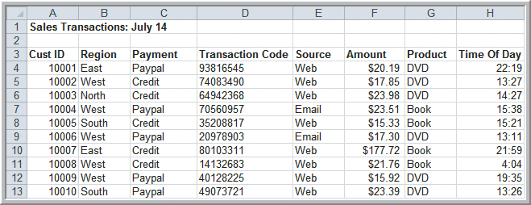
Statistical Methods for Summarizing Data
Example 21 Constructing a Cross-Tabulation
Sales Transactions database
Identify the number (and percentage) of books and DVDs ordered by region.

Slide 40
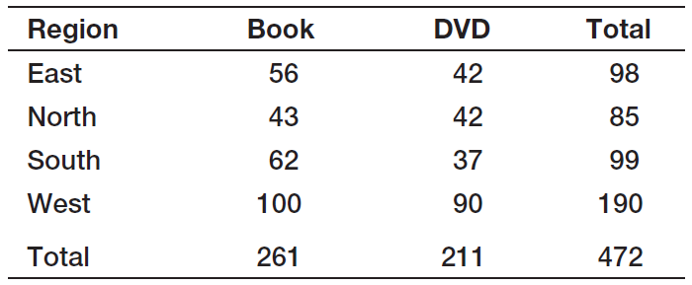
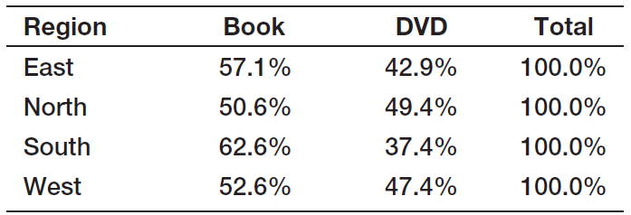
Statistical Methods for Summarizing Data
Example 21 (continued) Constructing a Cross-Tabulation

Slide 41
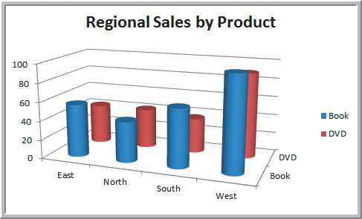
Statistical Methods for Summarizing Data
Example 21 (continued) Constructing a Cross-Tabulation
Excel’s PivotTable (covered next) makes this easy.

Slide 42
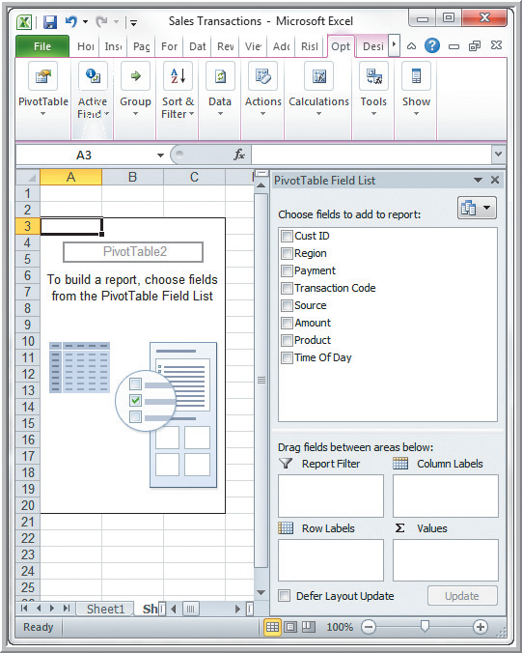
Exploring Data Using PivotTables
Data
Tables
PivotTable
Follow wizard steps.
PivotTables allow:
Quick creation of cross tabulations
Numerous custom-made summary tables and charts

Slide 43
Exploring Data Using PivotTables
PivotTable Field List
Select the fields for:
Report Filter
Column Labels
Row Labels
Σ Values
Or, before choosing PivotTable, you can select a cell in the data and let Excel prepare a default PivotTable.

Slide 44
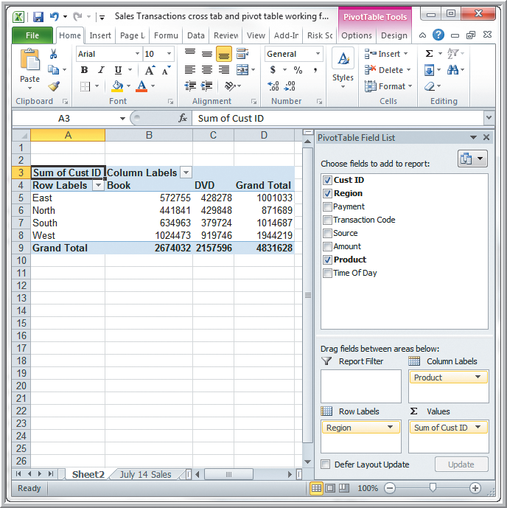
Exploring Data Using PivotTables
Example 22
Creating a PivotTable
Default PivotTable for Regional Sales by Product
(sum of CustID is meaningless)

Slide 45
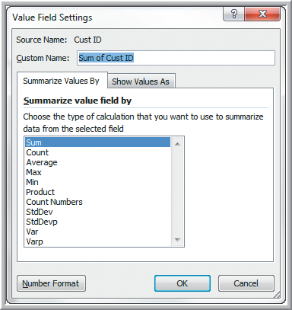
Exploring Data Using PivotTables
Example 22 (continued) Creating a PivotTable
Pivot Table Tools
Options
Active Field
Field Settings
Change summarization
method in Value Field
Settings dialog box
Select Count

Slide 46
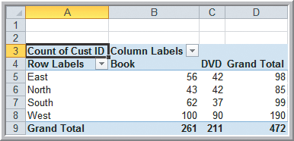
Exploring Data Using PivotTables
Example 22 (continued) Creating a PivotTable
PivotTable for Count of Regional Sales by Product
PivotTable results match those shown earlier in Table 3.1.

Slide 47
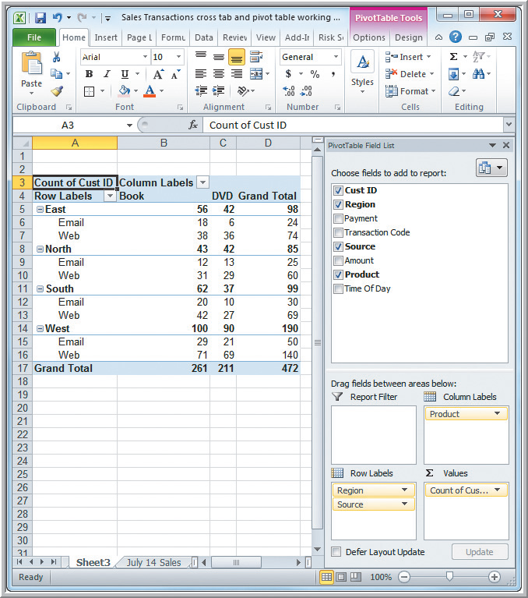
Exploring Data Using PivotTables
Example 22 (continued)
Creating a PivotTable
Drag Source into the Row Labels box.
PivotTable for Sales by Region, Product, and Order Source

Slide 48
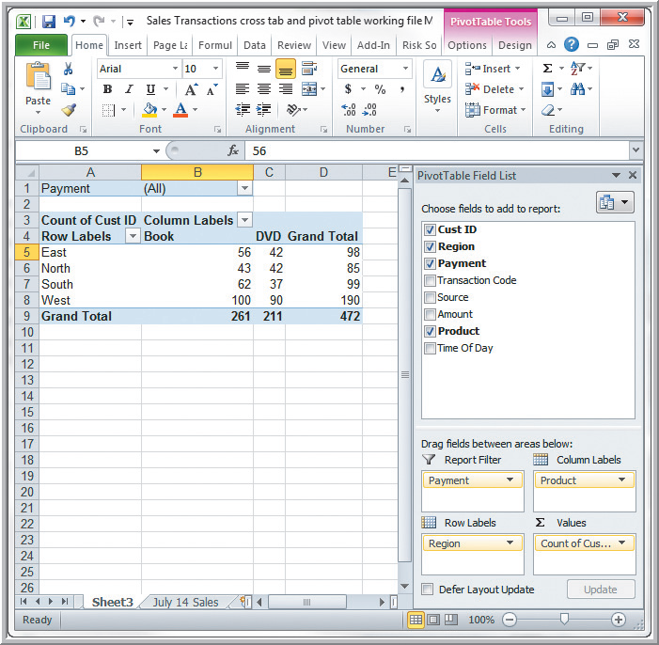
Exploring Data Using PivotTables
Example 23
Using the Pivot
Table Report Filter
Drag Payment into Report Filter box.
PivotTable Filtered by Payment Type.

Slide 49
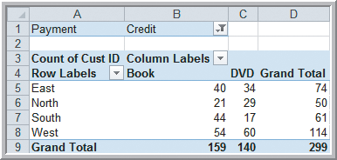
Exploring Data Using PivotTables
Example 23 (continued)
Using the PivotTable Report Filter
Click on the drop-down arrow in row 1.
Choose Credit-Card.
Obtain this cross-tabulation PivotTable for credit card transactions.

Slide 50
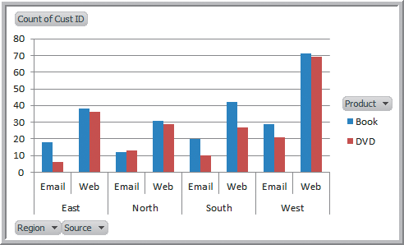
Exploring Data Using PivotTables
Example 24 A PivotChart for Sales Data
Create a chart using the PivotTable for
Sales by Region, Product, and Order Source.
Insert
Column Chart
To display only Book
data, click on the
Product button and
deselect DVD.

Slide 51
Key Terms
Area chart
Bar chart
Bubble chart
Column chart
Contingency table
Cross-tabulation
Cumulative relative frequency
Cumulative relative frequency distribution
Data profile (fractile)
Descriptive statistics
Doughnut chart
Frequency distribution
Histogram
k^{th} percentile
Line chart
Ogive
Pareto analysis
Pie chart

Slide 52
Key Terms (continued)
PivotChart
PivotTable
Quartile
Radar chart
Relative frequency
Relative frequency distribution
Scatter chart
Statistic
Statistics
Stock chart
Surface chart

